Slide 1
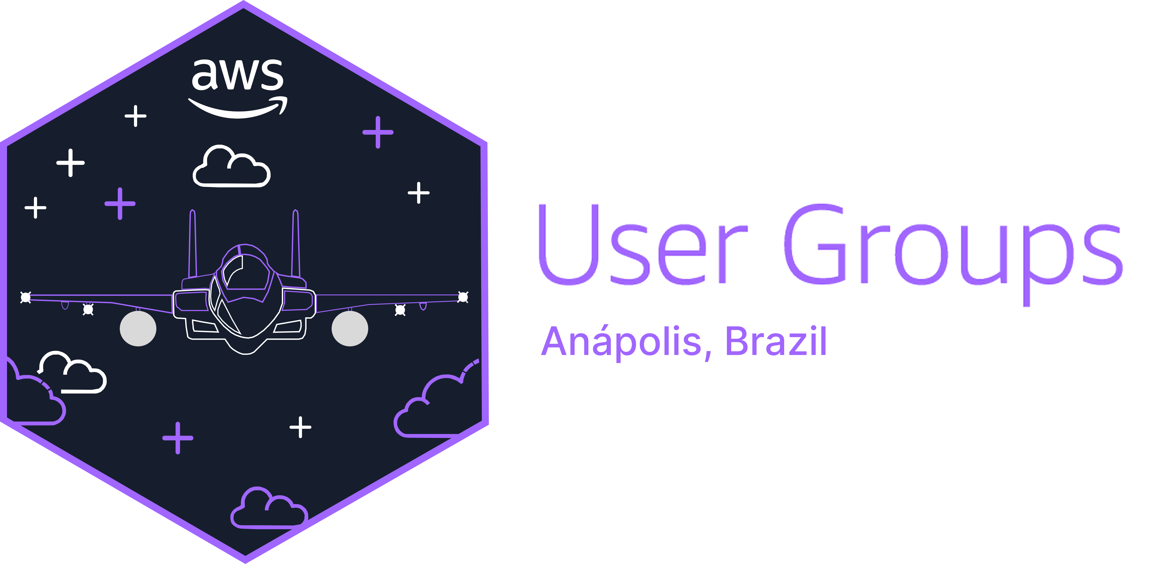
AWS Serverless: Simplificando Soluções em Nuvem

Slide 2
AWS Serverless: Simplifying Cloud Solutions

Slide 3

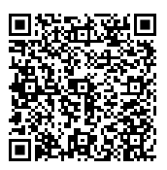
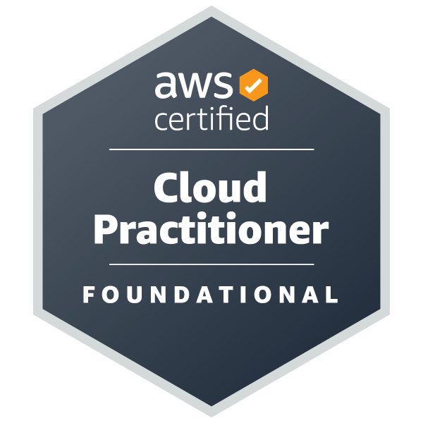
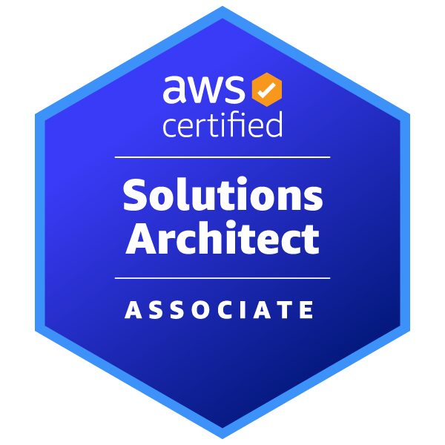
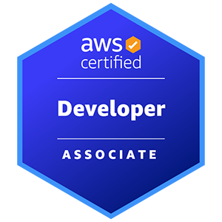
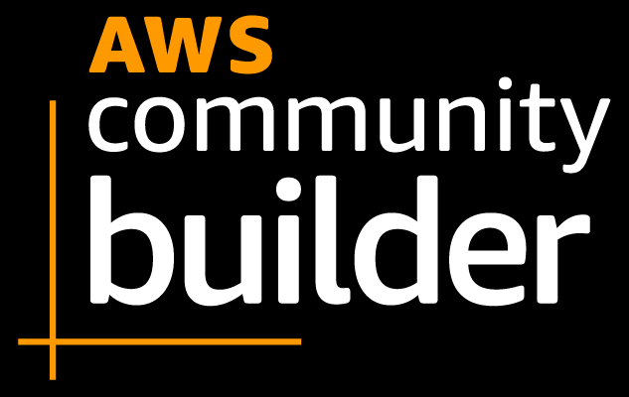



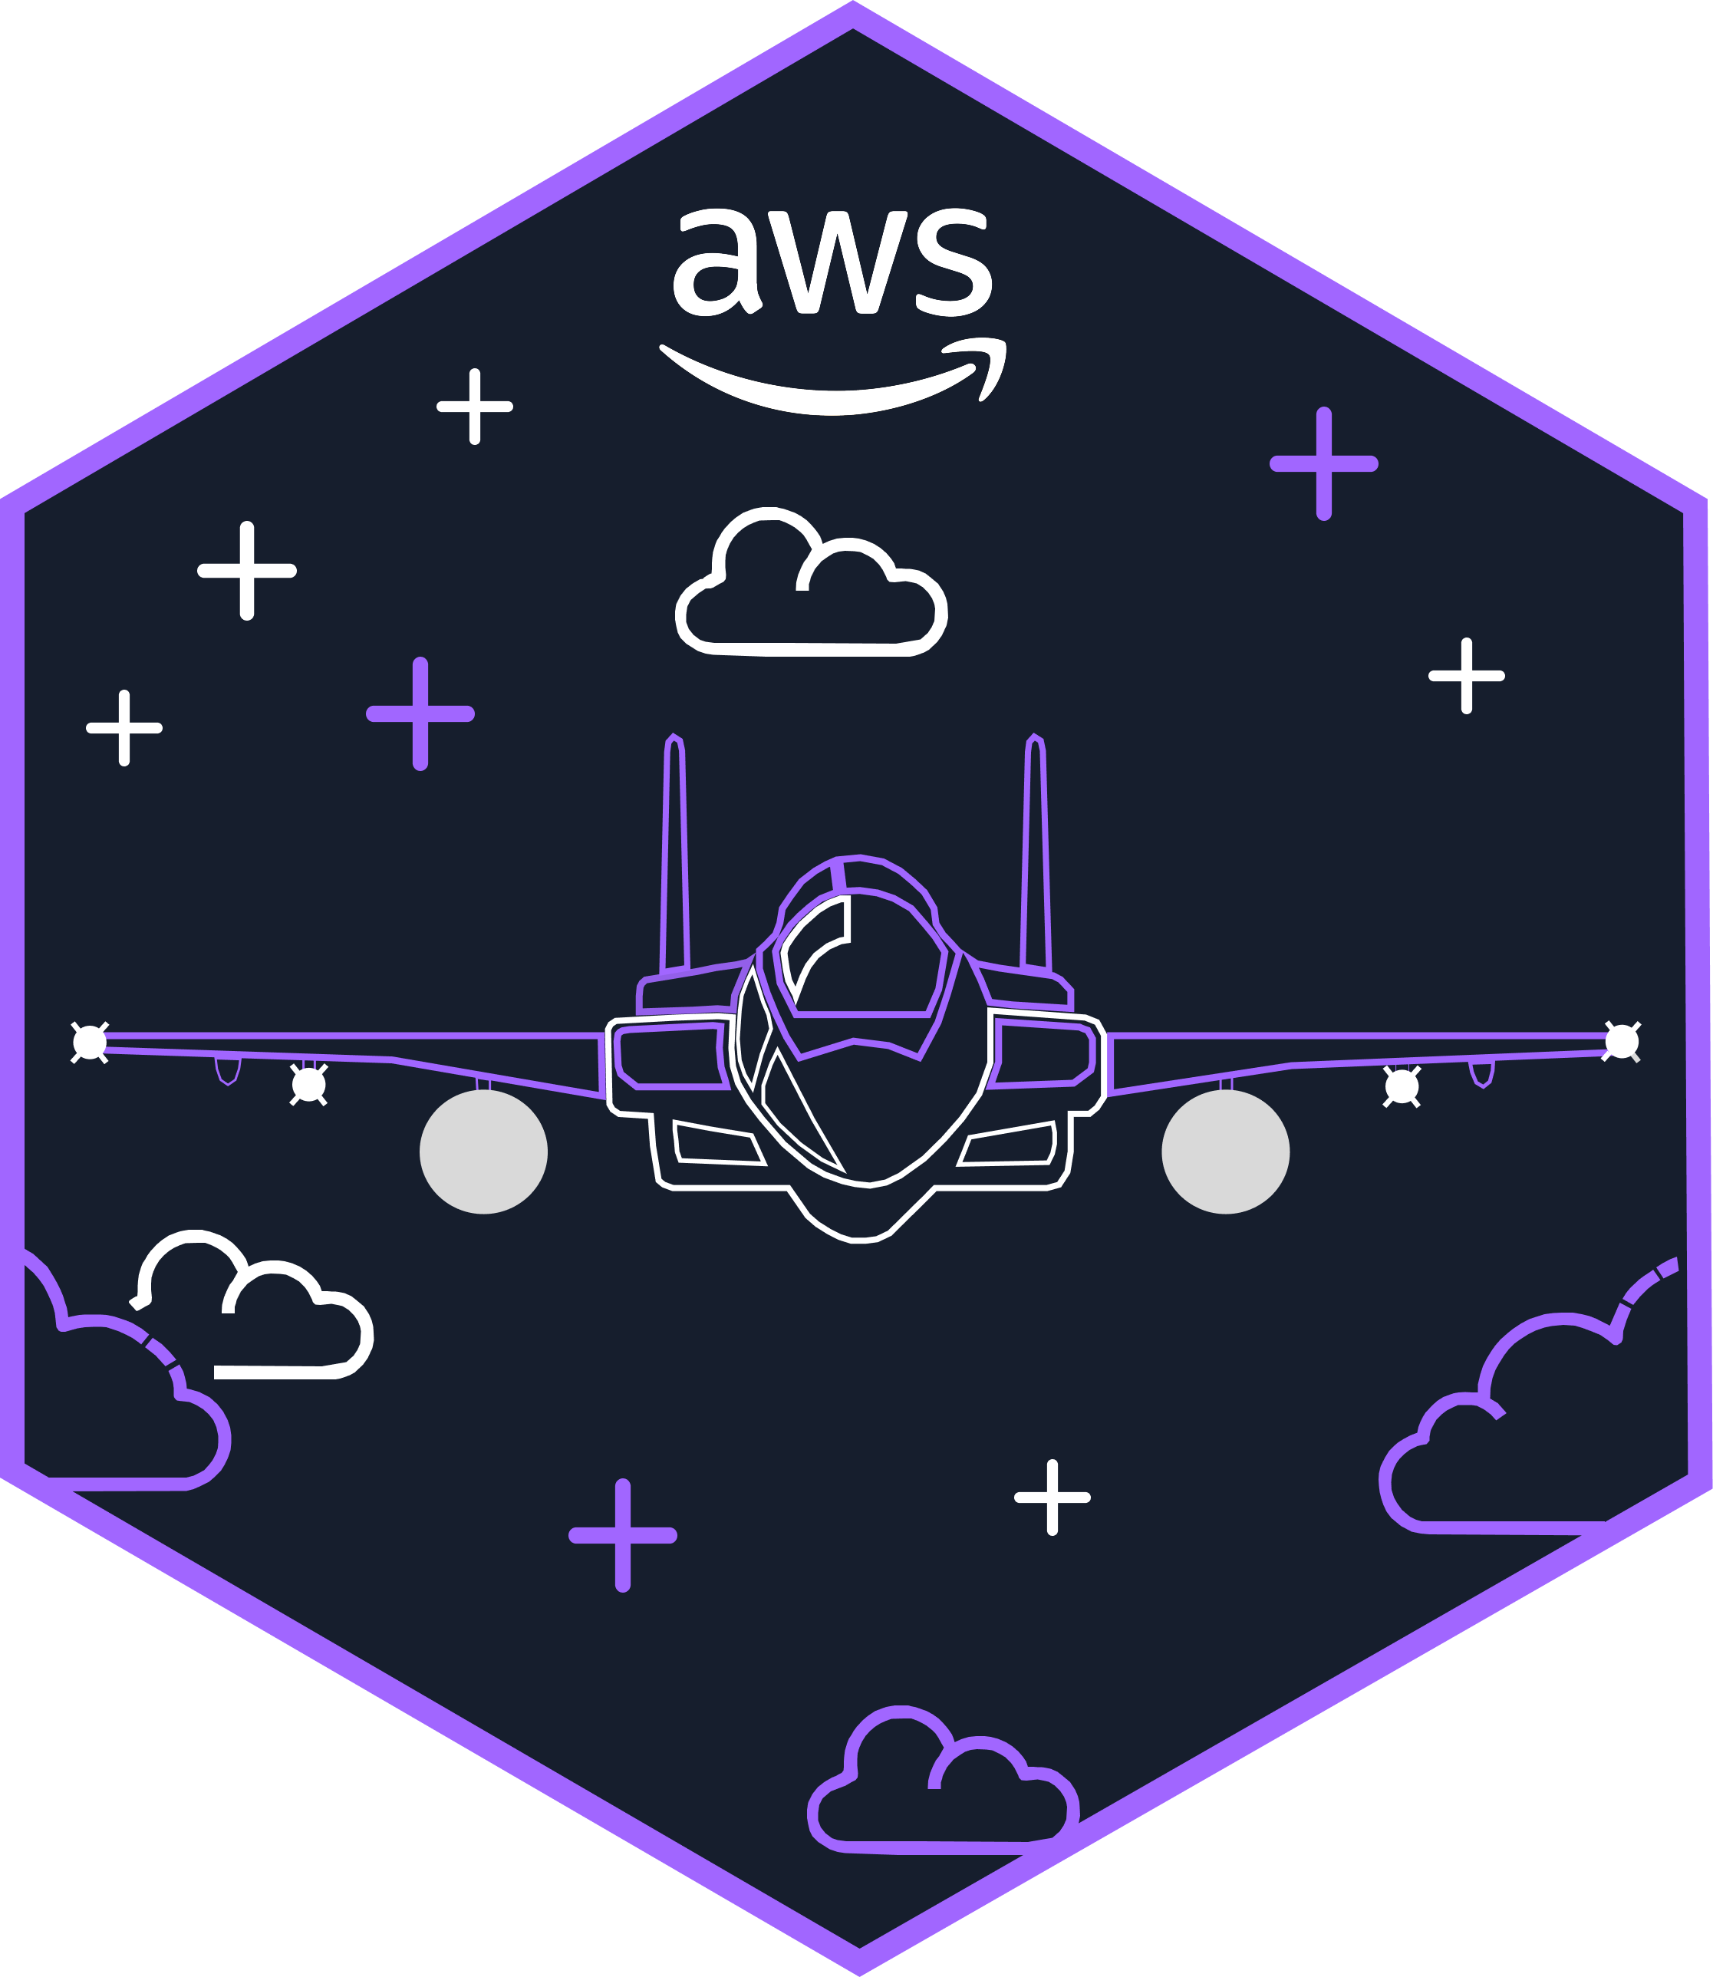


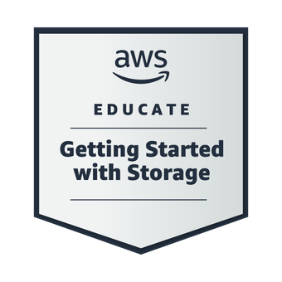
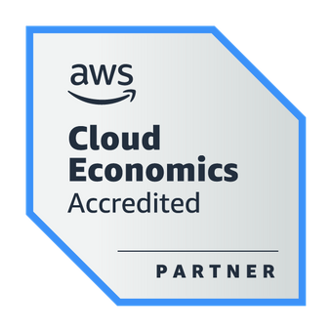
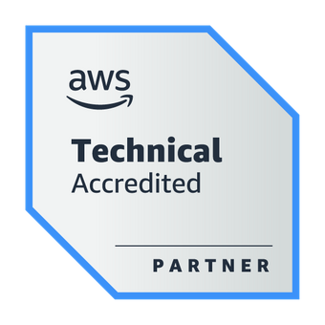
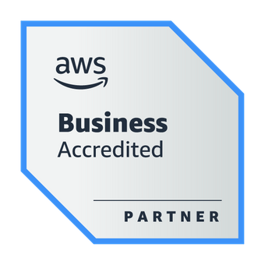
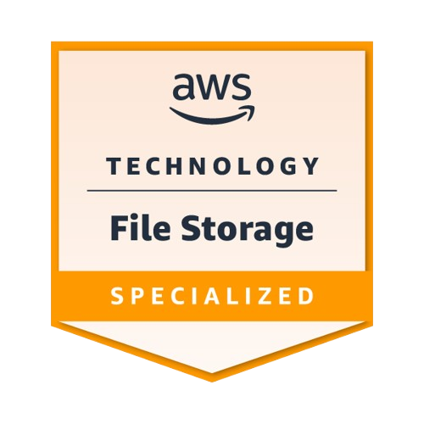
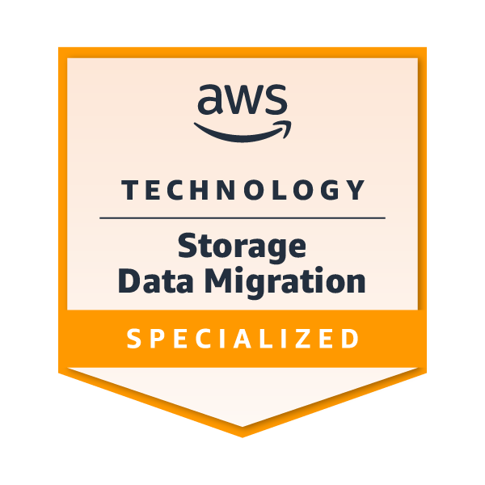
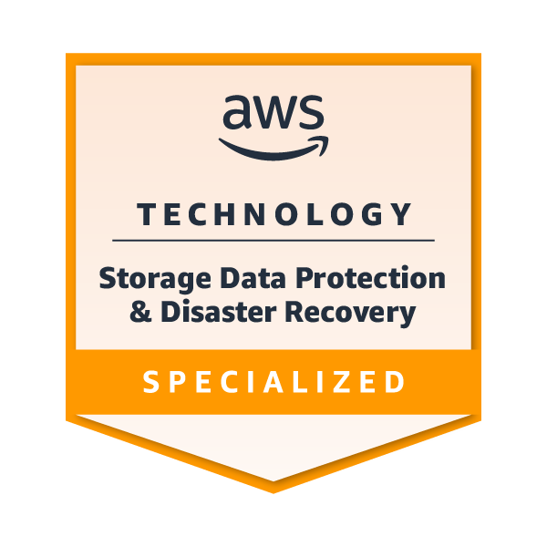
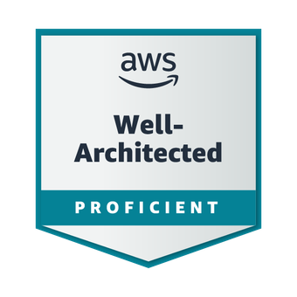
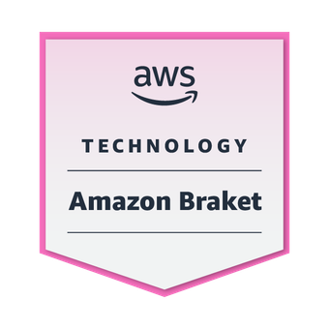
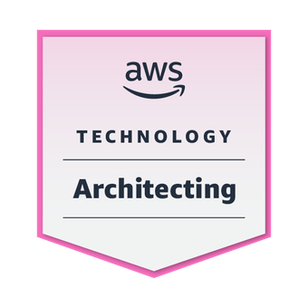
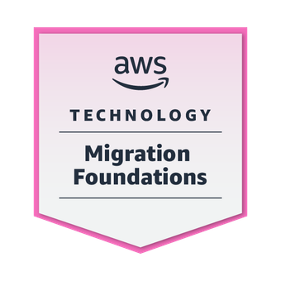
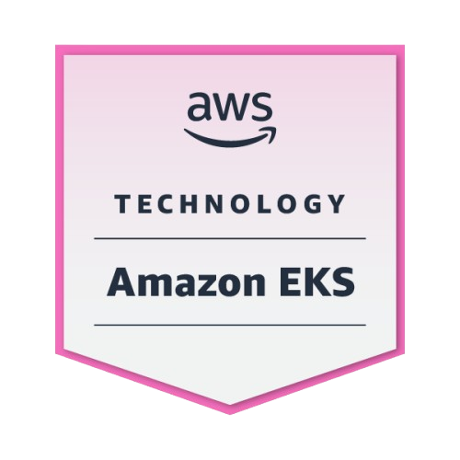
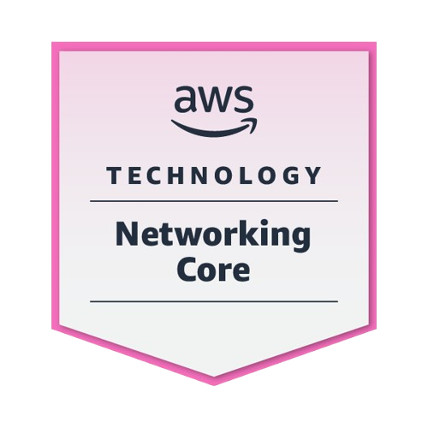
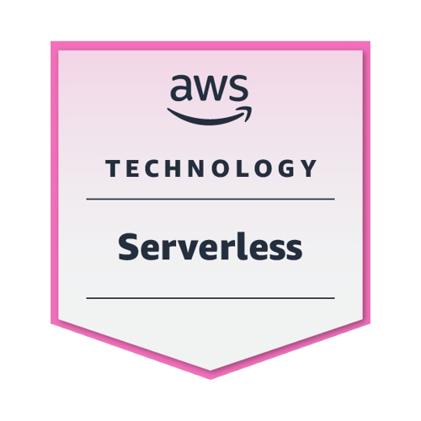
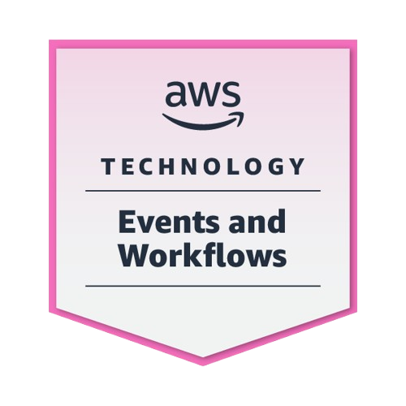
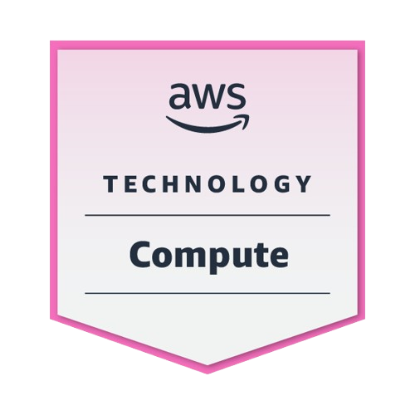
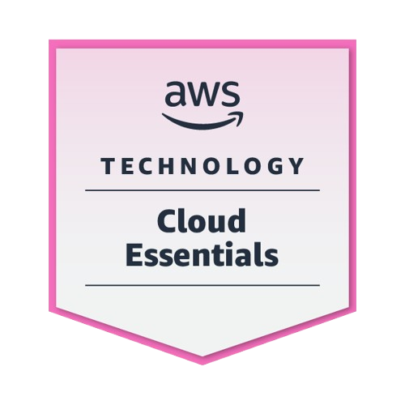
About the Speaker
Weder Mariano de Sousa
Specialist Senior Java - GFT
Technician System Development
Graduated Computer Science
Serverless
Post Graduate in Midias UFG
https://www.linkedin.com/in/wedermarianodesousa/
Post Graduate in Information Security
https://github.com/weder96
https://twitter.com/weder96
AWS User
Group Anápolis
Leader
GOJava
Leader
https://dev.to/weder96

Slide 4
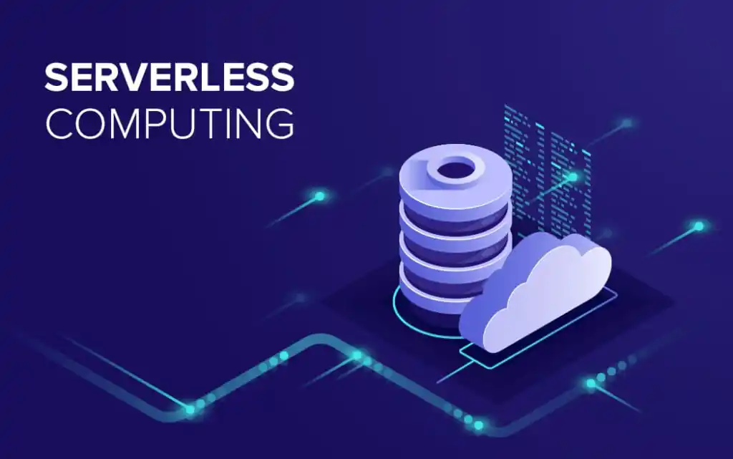


Slide 5
What is Serverless ?
“Removing the developer’s responsibility for configuring computational resources, leaving only the responsibility for writing the functions that make up the developed artifact “
[Hendrickson et al. 2016]
https://aws.amazon.com/serverless/?nc1=h_ls

Slide 6
What is AWS Serverless ?
AWS Serverless is a set of services offered by Amazon Web Services (AWS) that enable developers to build and run applications and services without having to manage the underlying infrastructure. With the serverless model, users can focus on application logic, while AWS automatically handles resource provisioning, scaling, and server administration. This approach facilitates agile development and increases efficiency by eliminating routine infrastructure management tasks.
https://aws.amazon.com/serverless/?nc1=h_ls

Slide 7
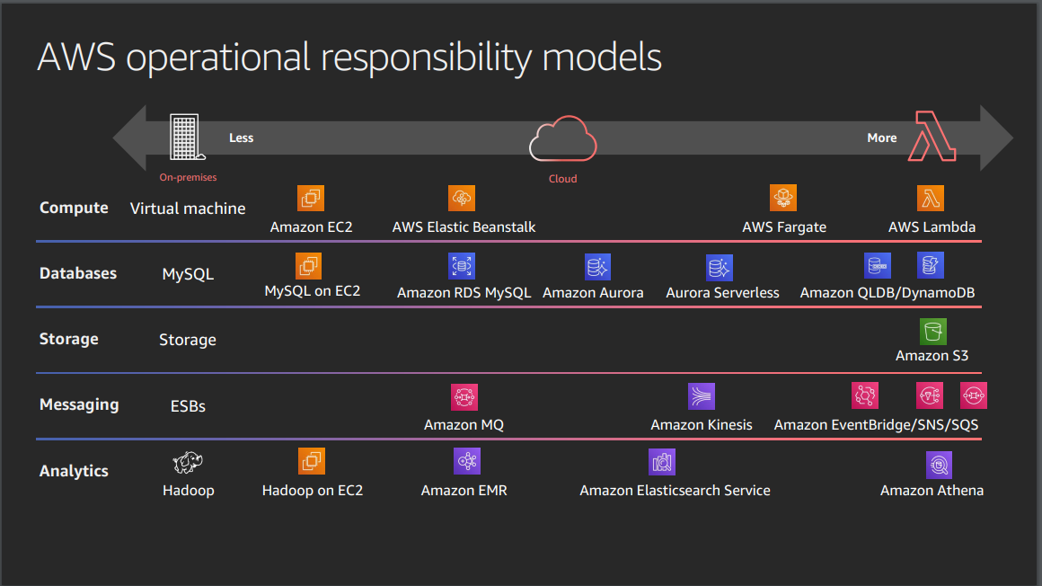

Serverless Explanained : AWS Operational Responsibility Model
https://d1.awsstatic.com/events/reinvent/2019/REPEAT_3_Serverless_architectural_patterns_and_best_practices_ARC307-R3.pdf

Slide 8
Comparison of operational responsibility
More opinionated
AWS Manages
Customer Manages
Data source integrations
- Physical hardware, software, networking,
and facilities
- Provisioning
- Application code
AWS Lambda
Serverless functions
- Container orchestration, provisioning
- Cluster scaling
- Physical hardware, host OS/kernel,
networking, and facilities
- Application code
- Data source integrations
- Security config and updates, network config,
management tasks
AWS Fargate
Serverless containers
- Container orchestration control plane
- Physical hardware software,
networking, and facilities
- Application code
= Data source integrations
-Work clusters
-Security config and updates, network config,
firewall, management tasks
ECS/EKS
Container-management as a service
- Physical hardware software,
networking, and facilities
- Application code
- Data source integrations
- Scaling
- Security config and updates, network config,
management tasks
- Provisioning, managing scaling and patching
of servers
EC2
Infrastructure-as-a-Service
Less opinionated

Slide 9





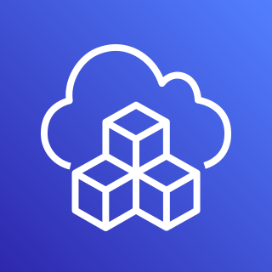




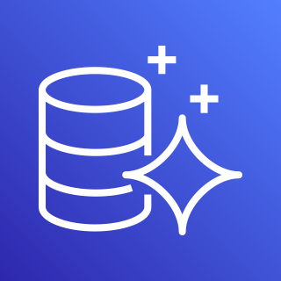
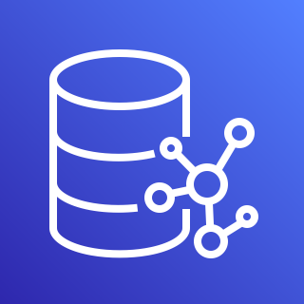
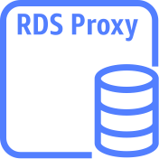






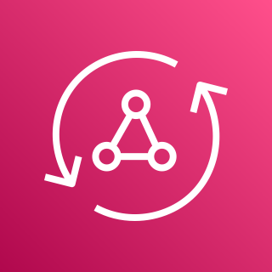

AWS Services Serverless
Compute
Authentication
and Authorization
Serverless Deployment
Frameworks
Application Integrations Services
AWS Lambda
AWS Fargate
Amazon Cognito
AWS CloudFormation
AWS CDK
Amazon
SNS
Amazon
SQS
Amazon
EventBridge
Data Persistence
Research and Analysis
Application Orchestration
DynamoDB
Aurora
Serverless
Neptune
Serverless
RDS
proxy instance
Amazon Redshift
OpenSearch
Service
AWS
Step Functions
Storing & Hosting
Streams
API and AppSync
Amazon S3
Amazon EFS
DynamoDB
Stream
Kinesis Data Streams
Amazon
API Gateway
AWS
AppSync
https://aws.amazon.com/serverless/?nc1=h_ls

Slide 10

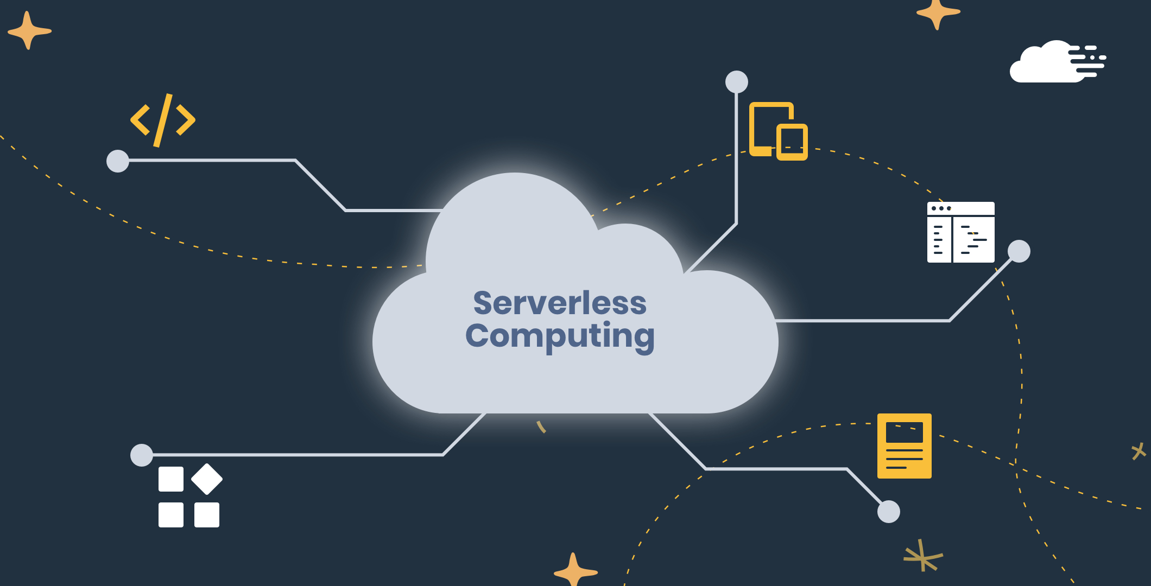
Why Serverless
Simplifies Cloud
Solutions ?

Slide 11

Why Serverless Simplifies Cloud Solutions ?
Reduced Infrastructure Management
Automatic Scalability
Consumption-Based Billing
Accelerated Development
Less Operational Overhead
Flexibility in Language and Tool Choice
Simple Deployment
Easy Integration
Resiliency and High Availability
Focus on business logic
Reduced Time to Market
Increased Security
Facilitated Microservices
Integrated Monitoring and Analytics
Easy Experimentation and Prototyping

Slide 12

Architecture
Serverless

Slide 13



Amazon SNS with AWS Management Console
AWS Cloud
Command CLI
Create
User
topic
Topic
AWS Command Line Interface (AWS CLI)
Amazon Simple Notification Service (Amazon SNS)

Slide 14




Amazon SQS Queue Polling From AWS Lambda
AWS Cloud
Send /Messages
EventType =
Poll-based
User
Queue
Lambda
function
Amazon Simple Queue Service (Amazon SQS)
Event Filter
AWS Lambda

Slide 15

Microservices “REST”
AWS Cloud
service1.example.com
Amazon API Gateway
AWS Lambda
Amazon DynamoDB
microservice1
Client
AWS Cloud
service2.example.com
Amazon API Gateway
AWS Lambda
Amazon DynamoDB
microservice2

Slide 16



Build Serverless Chat App with a WebSocket API and Lambda
AWS Cloud
$connect route
$default route
WSS
send Message
route
Users
WebSocket
API
Amazon DynamoDB
{
"action": "sendMessage",
"message": "Hello from websocket !"
}
$disconnect
route
Lambda function
https://docs.aws.amazon.com/apigateway/latest/developerguide/websocket-api-chat-app.html

Slide 17

Secure your API Gateway with Amazon Cognito User Pools
AWS Cloud
Authenticate
token
Amazon Cognito
Verify token
Client
HTTP Call
with token
Amazon API
Gateway
AWS Lambda
Amazon DynamoDB

Slide 18





Using an Amazon S3 trigger to invoke a Lambda function
AWS Cloud
Amazon S3
AWS Lambda
Amazon CloudWatch
Permissions policy
Upload Object
in bucket
Bucket with
objects
Lambda function
Logs
Client
https://docs.aws.amazon.com/lambda/latest/dg/with-s3-example.html

Slide 19
AWS Lambda Destination to SQS - DLQ Case
AWS Cloud
Amazon S3
AWS Lambda
Amazon SQS
Permissions policy
Upload Object
in bucket
Bucket with
objects
Lambda function
Queue
Client
https://docs.aws.amazon.com/lambda/latest/dg/with-s3-example.html

Slide 20
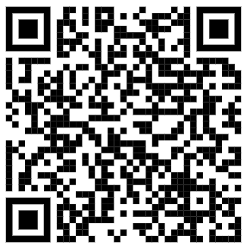
Using an Amazon SNS to send message to Lambda function
AWS Cloud
Amazon SNS
AWS Lambda
Amazon CloudWatch
Permissions policy
CLI - Command
line Interface
Amazon SNS
Standart Topic
Lambda function
CloudWatch
Logs
Client
https://docs.aws.amazon.com/lambda/latest/dg/with-sns-example.html

Slide 21




Processing performance with Amazon Kinesis Data Streams and AWS Lambda
Front Ends
AWS Cloud
AWS Lambda functions
Client
Bucket S3
Mobile client
Insert Item
Amazon
DynamoDB Table
Amazon Kinesis Data Streams
Traditional server
Amazon Kinesis Data Streams
Users
https://aws.amazon.com/blogs/compute/increasing-real-time-stream-processing-performance-with-amazon-kinesis-data-streams-enhanced-fan-out-and-aws-lambda/

Slide 22

Command, Publish, Consume, Query (CPCQ)
AWS Cloud
User
AWS Lambda
(Command)
Amazon DynamoDB
(DB)
AWS Lambda
(publish)
microservice1
Amazon EventBridge
AWS Cloud
User
AWS Lambda
(query)
Amazon DynamoDB
(DB)
AWS Lambda
(Consumer)
microservice2

Slide 23
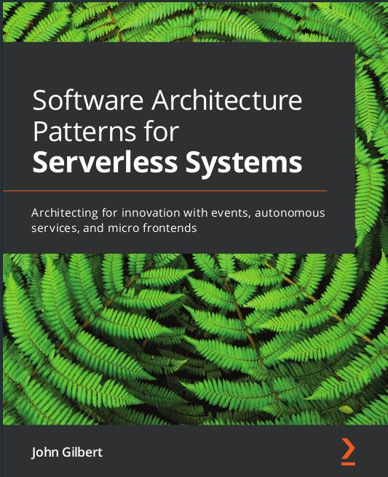
Event hub
Producer
Event Hub
Consumer
hub
stream
AWS Lambda
EventBridge
Amazon
Kinesis
AWS Lambda
Event Lake
Amazon S3
OpenSearch

Slide 24


Saga Pattern For Orchestrate Distributed Transaction (AWS StepFunctions)
AWS Cloud
Order Orchestrate
Client
Fail
/order
x-api-key
100 RPS
50 burst
Order
Table(Orders)
API Gateway
Microservice
Is Success
Fail
Remove Order
Inventory
Table(Inventory)
Microservice
Is Success
Fail
Revert Inventory
Payment
Table(Payment)
Microservice
Is Success
Fail
Revert Payment
Amazon CloudWatch
Success

Slide 25


Circuit Breaker and Many More by Jeremy Daly
AWS Cloud
Increment Failure Count
ElastiCache
open
Status?
close
Third Party API
User
Amazon API
Gateway
AWS Lambda
half open(fail)
half open(try)

Slide 26

Fan-Out Serverless Architectures Using SNS, SQS and Lambda
AWS Cloud
EventType=
Poll-based
Queue
Amazon SQS
Notification
Client
publish
Message
EventType=
Poll-based
x-api-key
100 RPS
50 burst
Queue
API Gateway
(Rest)
AWS Lambda
(Order Microservice)
Amazon SNS
Amazon SQS
Inventory
EventFilter
EventType=
Poll-based
Queue
Amazon DynamoDB
(Order Table)
Amazon SQS
Shipment
Amazon CloudWatch
Stack
AWS CloudFormation and CDK

Slide 27
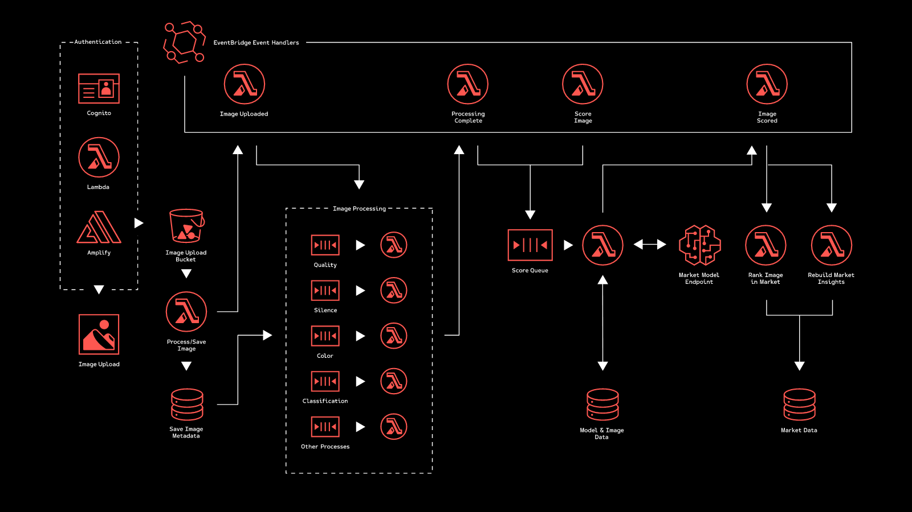

Joot’s Serverless Architecture (Joot uses for image processing)
https://www.serverless.com/blog/serverless-architecture

Slide 28
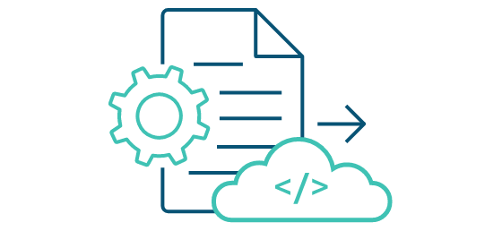


How to build, run and deploy?
When starting designing, and building serverless function, you might wonder how to deploy your function into the cloud. With AWS, there are some ways we can deploy, test and invoke your function:
Using the AWS Console Management: we can create lambda function, upload code, add triggers, and test your Lambda function manually. You might use this way when first.
AWS CLI: you also can use AWS Lambda CLI to create, deploy, invoke, manage, monitor your Lambda function. You can use existing commands to deploy and test your Lambda function automatically without manual process. But this isn’t good for production and large project.
AWS Serverless Application Model (AWS SAM) is an open-source framework for building serverless applications. It provides shorthand syntax to express functions, APIs, databases, and event source mappings.
AWS Cloud Development Kit (AWS CDK) is an open source software development framework to define your cloud application resources using familiar programming languages.
https://aws.amazon.com/serverless/getting-started/?nc=sn&loc=2&serverless.sort-by=item.additionalFields.createdDate&serverless.sort-order=desc

Slide 29
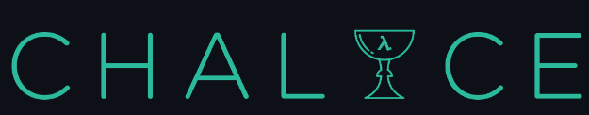


How to build, run and deploy?
Serverless Framework - The Serverless Framework consists of an open source CLI and a hosted dashboard. Together, they provide you with full serverless application lifecycle management.
Chalice is a framework for writing serverless apps in Python. It allows you to quickly create and deploy applications that use AWS Lambda.
Arc.codes provides everything you need to build massively scalable serverless apps with low code, clear and terse config, and zero ceremony.
Claudia.js makes it easy to deploy Node.js projects to AWS Lambda and API Gateway.
https://aws.amazon.com/serverless/getting-started/?nc=sn&loc=2&serverless.sort by=item.additionalFields.createdDate&serverless.sort-order=desc

Slide 30
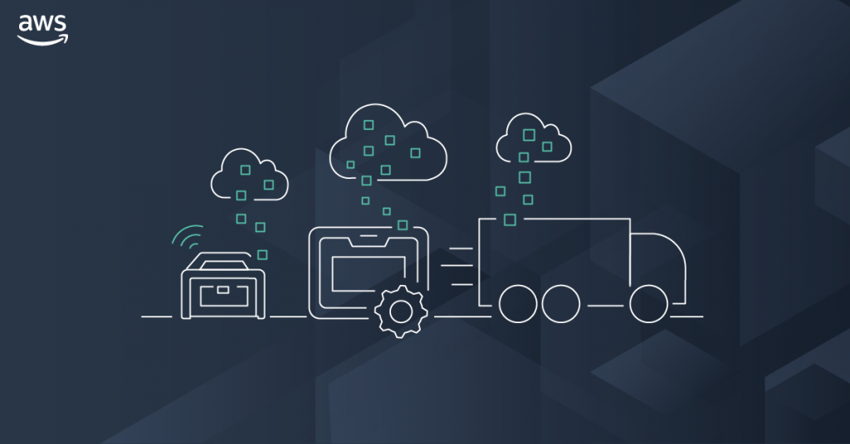
AWS Storage

Slide 31
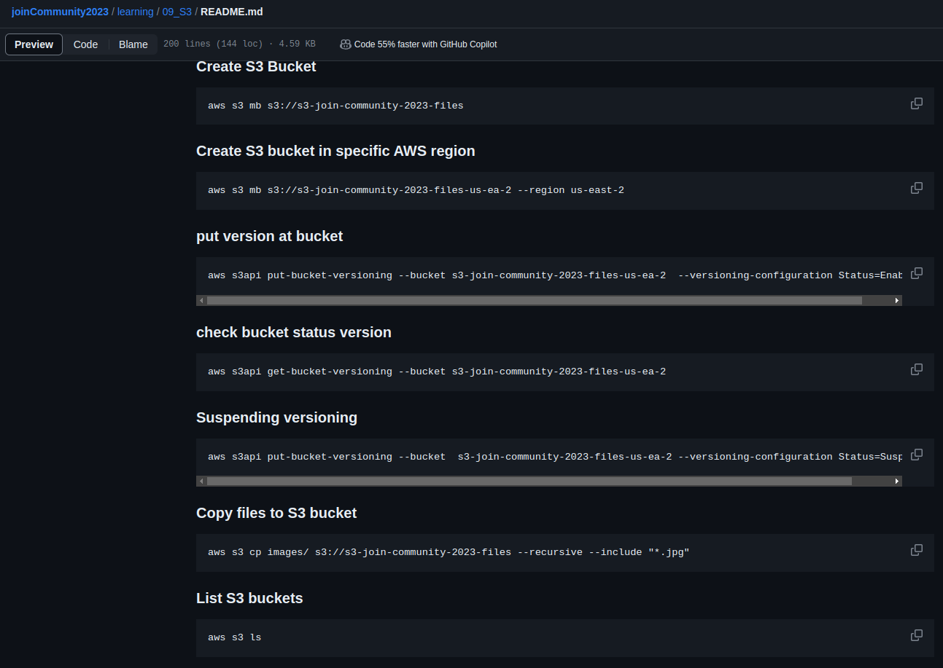

Amazon S3 CLI Commands
Amazon S3
https://github.com/weder96/joinCommunity2023/blob/main/learning/09_S3/README.md

Slide 32
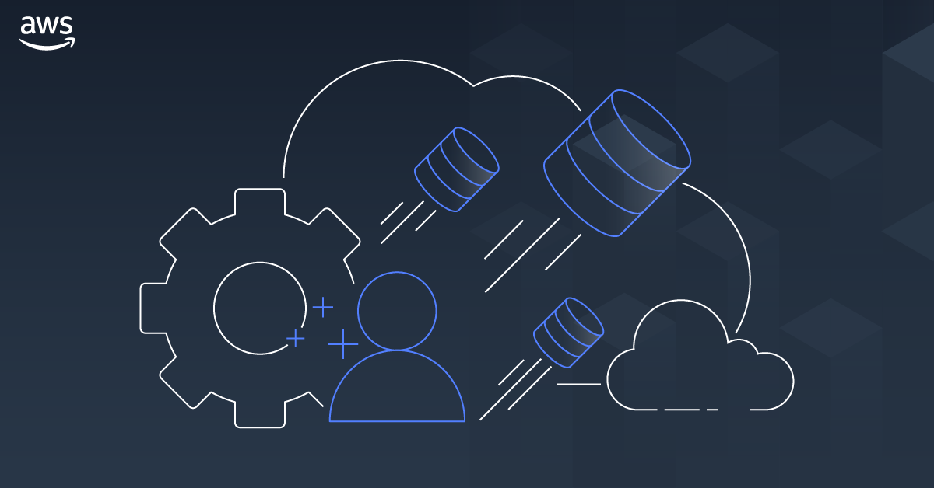
AWS Database

Slide 33
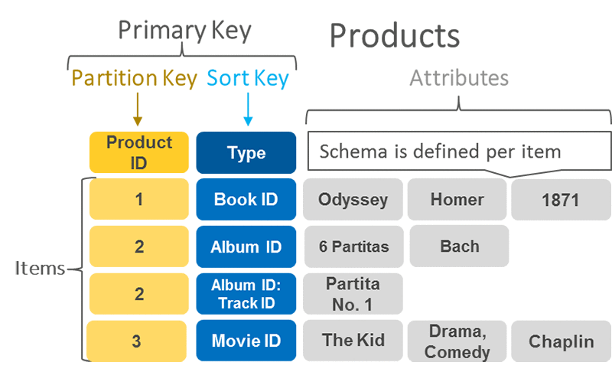
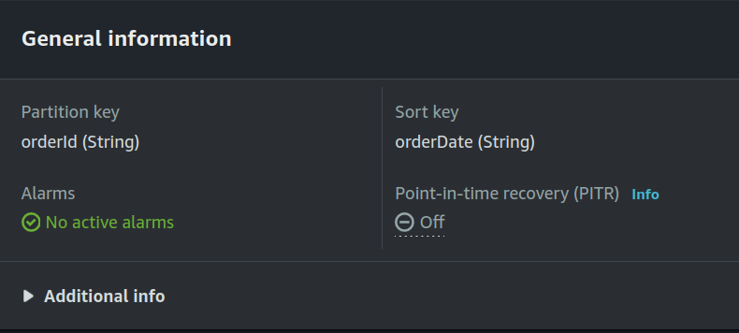
DynamoDB Primary Key, Partition Key and Sort Key
A primary key uniquely identifies each item in the table, so no
two items can have the same key. DynamoDB supports two
different kinds of primary keys:
Partition key
Partition key and sort key
Partition key
A simple primary key, composed of one attribute known as the
partition key.
Partition key and Sort Key
It is Referred to as a composite primary key, this type of key is
composed of two attributes. The first attribute is the partition
key, and the second attribute is the sort key.
DynamoDB uses the partition key value as input to an internal
hash function. A composite primary key gives you additional
flexibility when querying data
https://aws.amazon.com/blogs/database/choosing-the-right-dynamodb-partition-key/

Slide 34
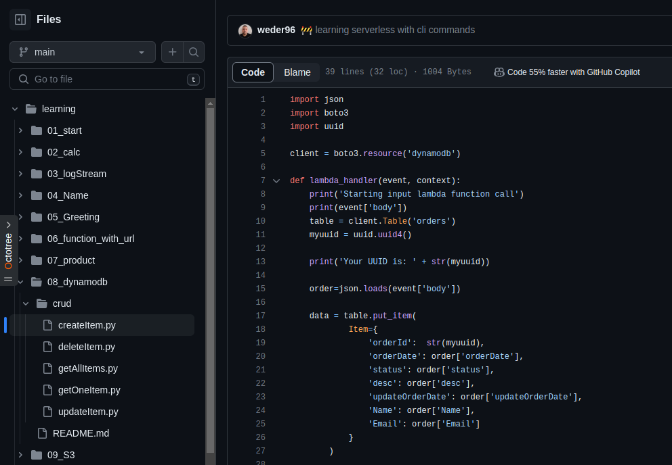

DynamoDB Python(Boto3)
https://github.com/weder96/joinCommunity2023/tree/main/learning/08_dynamodb

Slide 35
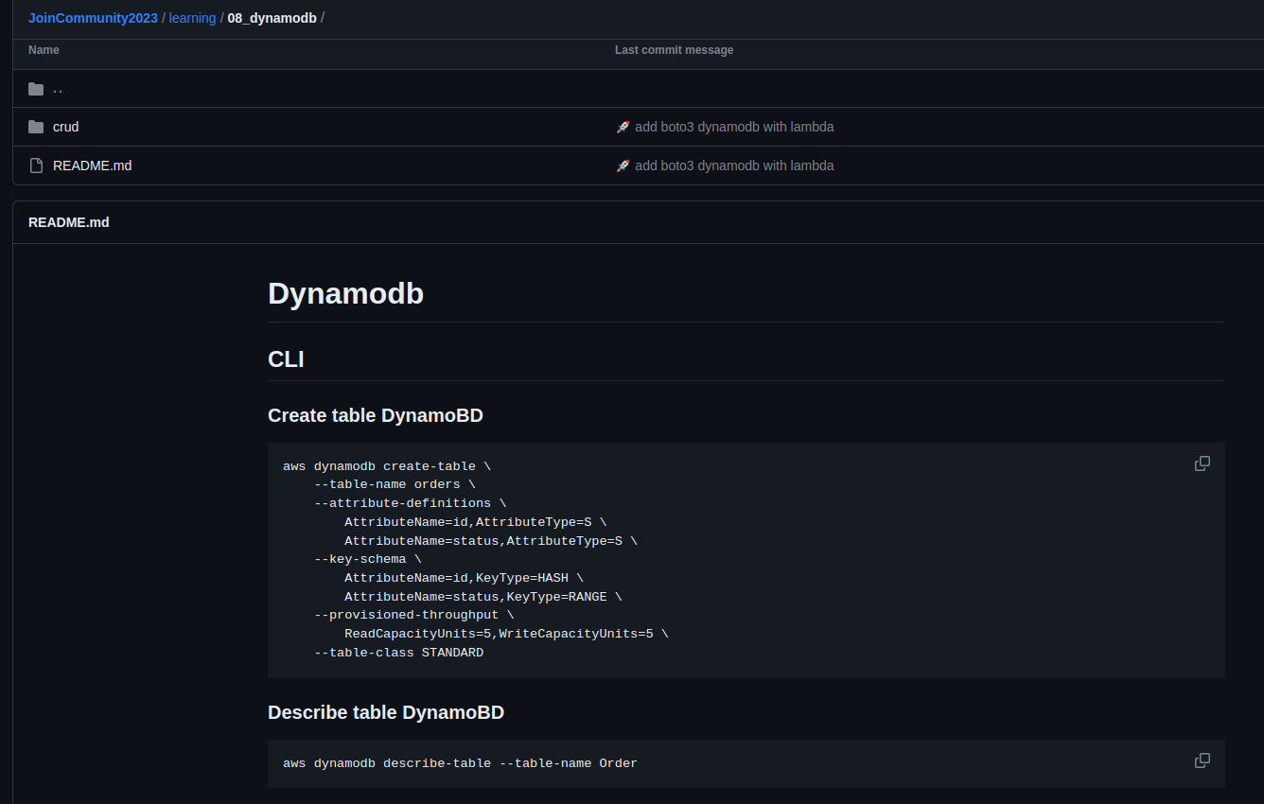
DynamoDB CLI Commands
https://github.com/weder96/joinCommunity2023/tree/main/learning/08_dynamodb

Slide 36
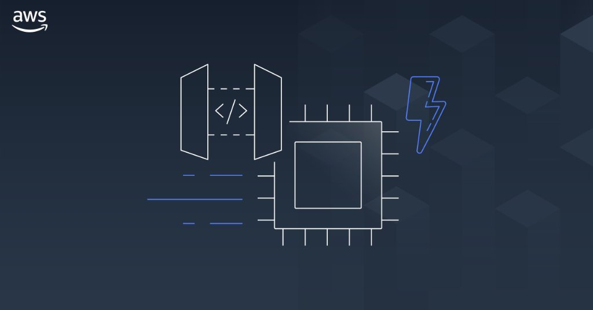
AWS API Gateway

Slide 37
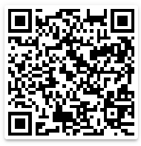
Amazon API Gateway Concepts
API Deployment – a point-in-time snapshot of your API Gateway API resources and methods. To be available for clients to use, the deployment must be associated with one or more API stages.
API endpoints – host names APIs in API Gateway, which are deployed to a specific region and of the format: rest-api-id.execute-api.region.amazonaws.com
API key – An alphanumeric string that API Gateway uses to identify an app developer who uses your API.
API stage – A logical reference to a lifecycle state of your API. API stages are identified by API ID and stage name.
Model – Data schema specifying the data structure of a request or response payload.
Private API – An API that is exposed through interface VPC endpoints and isolated from the public internet
Private integration – An API Gateway integration type for a client to access resources inside a customer’s VPC through a private API endpoint without exposing the resources to the public internet.
Proxy integration – You can set up a proxy integration as an HTTP proxy integration type or a Lambda proxy integration type.
Usage plan – Provides selected API clients with access to one or more deployed APIs. You can use a usage plan to configure throttling and quota limits, which are enforced on individual client API keys.
Amazon
API Gateway
https://github.com/weder96/aws-certification-learning/tree/main/module-5#section-10

Slide 38

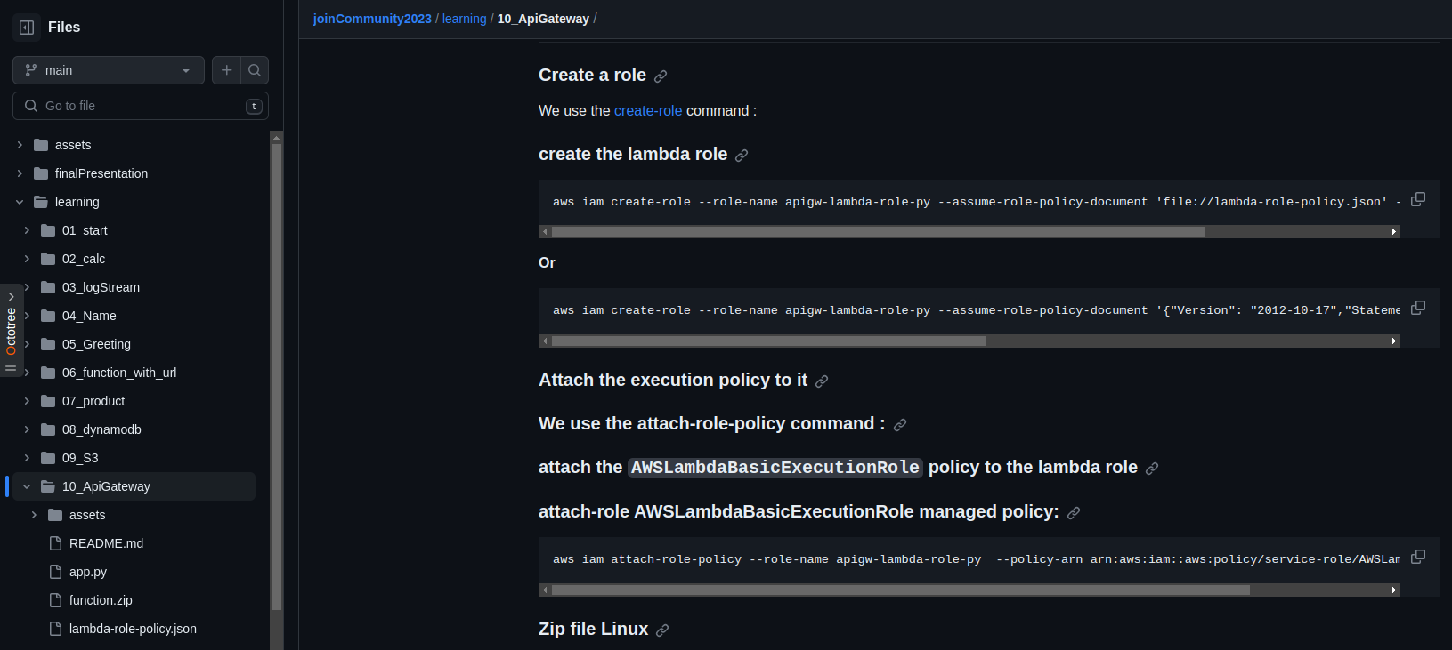
Amazon API Gateway CLI Commands
Amazon
API Gateway
https://github.com/weder96/joinCommunity2023/tree/main/learning/10_ApiGateway

Slide 39
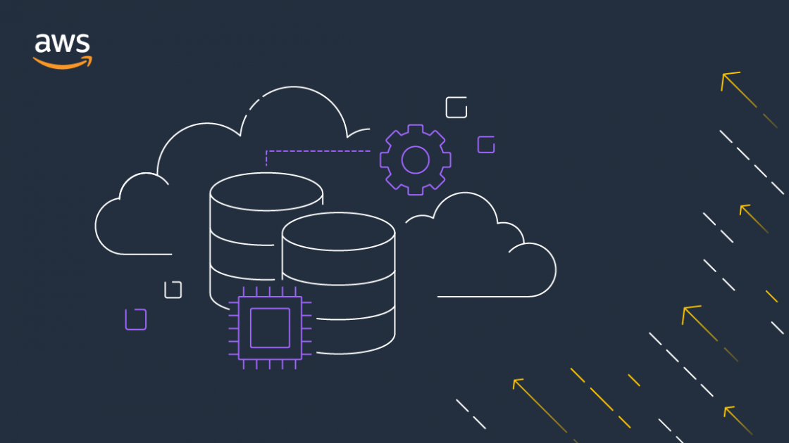

AWS Application Integration
SNS
SQS
EVENTBRIDGE

Slide 40
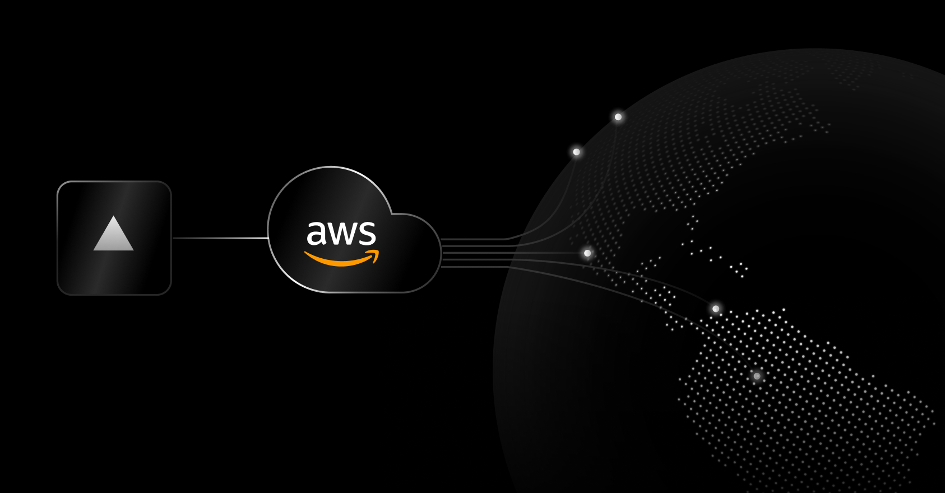
Amazon SNS

Slide 41
Amazon SNS: Fully Managed Pub/Sub Messaging
Application
Integration
Application integration
The Fanout scenario is when a message published to an SNS topic is replicated and pushed to multiple endpoints.
Application alerts
Amazon SNS can send notifications to specified users via SMS and email.
User notifications
Amazon SNS can send push email messages and text messages to individuals or groups.
Mobile push notifications
Mobile push notifications enable you to send
messages directly to mobile apps.
Amazon SNS
Amazon SQS
AWS Lambda
EventType=
Poll-based
Queue
Lambda Function
Messages
1,2,3,....
Topic
EventType=
Poll-based
Queue
Lambda Function

Slide 42
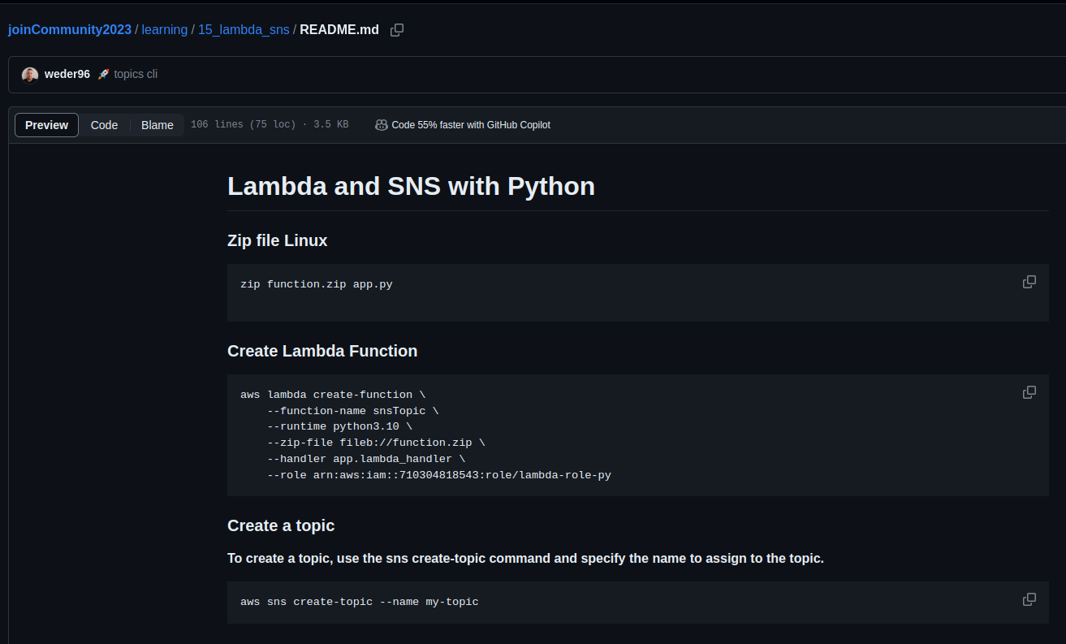

Amazon SNS CLI Commands and (Python) Boto3
Amazon SNS
https://github.com/weder96/joinCommunity2023/blob/main/learning/15_lambda_sns/README.md

Slide 43

Amazon SQS

Slide 44
What is Amazon SQS ?
Application
Integration
Amazon SQS stands for Simple Queue Service is fully managed message queues for microservices,
distributed systems, and serverless applications.
Enables you to decouple and scale microservices, distributed systems, and serverless applications.
Eliminates the complexity and overhead associated with managing and operating message-oriented
middleware.
Send, store, and receive messages between software components at any volume.
Two types of message queues.
Standard queues offer maximum throughput, best-effort ordering, and at-least-once delivery.
FIFO queues are designed to guarantee that messages are processed exactly once, in the exact order that they are sent.
Integrate and decouple distributed software systems and components.
Provides a generic web services API that you can access using any programming language that the AWS
SDK supports.
Amazon SQS
https://aws.amazon.com/sns/?nc1=h_ls

Slide 45
Amazon SQS What’s a queue?
Application
Integration
Send Messages
Pool messages
Producer
consumer
Producer
consumer
Queue
consumer
Producer
consumer
Amazon SQS
https://aws.amazon.com/sns/?nc1=h_ls

Slide 46


Amazon SQS CLI Commands and (Python) Boto3
Application
Integration
Amazon SQS
https://github.com/weder96/joinCommunity2023/blob/main/learning/16_lambda_sqs/README.md

Slide 47

Amazon EventBridge

Slide 48

What is Amazon EventBridge ?
Serverless event bus service for AWS services
Build event-driven applications at scale using events generated from your apps
Use to connect your applications with data from a variety of sources.
Integrated SaaS applications
AWS services to targets such as AWS Lambda functions
Formerly called Amazon CloudWatch Events
https://serverlessland.com/patterns
https://da-public-assets.s3.amazonaws.com/serverlessland/pdf/2021+-+Serverlesspresso+exhibit+-+PDF.pdf

Slide 49

What are events?
An event is defined in JSON
"Detail" is application specific
Envelope attributes are provided by
Amazon EventBridge
Producers create events
Consumers choose which events to
Listen to by using rules
https://da-public-assets.s3.amazonaws.com/serverlessland/pdf/2021+-+Serverlesspresso+exhibit+-+PDF.pdf

Slide 50


Understanding EventBridge target
Does not know about
consumers decoupled
Bus need permissions
to talk to targewt(ex lambda)
Eventbus
rule
target
filter out events
Eventbus
rule
Also knoe as
consumer
Target Example
Lambda
What are target ?
Targets are consumer of you events
use rules to process events before reaching targets
Target Permissions
Your eventBridge bus need permissions
to send events to targets
Serverless Visuals: Small bite sized visuals about Amazon EventBridge David Boyne

Slide 51


Amazon EventBridge CLI Commands and (Python) Boto3
Amazon EventBridge
https://github.com/weder96/joinCommunity2023/blob/main/learning/19_eventbridge/README.md

Slide 52

AWS Application Orchestration
STEP FUNCTIONS

Slide 53

AWS Step Functions

Slide 54












State types
Task
A single unit of work
Choice
Adds branching logic
Parallel
Fork and join the data across tasks
Wait
Delay for a specified time
Fail
Stops an execution and marks it as a failure
Succeed
Stops an execution successfully
Pass
Passes its input to its output
Map
Loop and Foreach

Slide 55


Create a Serverless Workflow with AWS Step Functions and AWS Lambda
https://aws.amazon.com/pt/tutorials/create-a-serverless-workflow-step-functions-lambda/

Slide 56


Amazon Step Functions CLI Commands and (Python) Boto3
AWS Step Functions
https://github.com/weder96/joinCommunity2023/blob/main/learning/21_step_function/README.md

Slide 57

AWS Lambda Overview

Slide 58
AWS Lambda Overview
Serverless on AWS, Build and run applications without thinking about servers
The most popular serverless compute platform that is using millions of customer
Running billions of invocations all over the world
Compute service that runs code without thinking any servers or underlying services
Serverless function that you only responsible for your actual code.
https://aws.amazon.com/serverless/?nc1=h_ls
https://aws.amazon.com/blogs/compute/serverless-icymi-q2-2023/

Slide 59


AWS Lambda Invocation Types
Triggered lambda functions with different AWS Lambda Invocation Types
AWS Lambda has 3 Invocation Types;
Lambda Synchronous invocation
Lambda Asynchronous invocation
Lambda Event Source Mapping with polling invocation
https://aws.amazon.com/blogs/architecture/understanding-the-different-ways-to-invoke-lambda-functions/

Slide 60

Lambda Function Code
AWS Lambda runs instances of your function to process
events.
Invoke function directly using the Lambda API, or
configure an AWS service or resource to invoke your function.
Lambda function has code to process the events
that you pass into the function or that other AWS
services send to the function with event json object.
The event object contains all the information about
the event that triggered this Lambda.
The context object contains info about the runtime
our Lambda function
Return the function with the results

Slide 61


AWS Lambda Execution Role
Resource Based
Policy
Execute Role
Policy
AWS Lambda Permissions
Lambda Execution Role
Resource-based policy
Lambda Execution Role
IAM role that Lambda has permissions to assume when invoking
lambda function.
Create an execution role when creating a new lambda function, and
after that we can also modify the policies associated with the IAM role.
if you have additional targets from your lambda function
performing crud operations on DynamoDB table
sending notification to SNS
retrieve messages from queue or streams
Lambda function's execution role required permissions to
interact with those AWS services
Grant least privilege access to your Lambda execution role
Who can Invoke
Lambda ?
Who can interact
Lambda Invoke ?
AWS Lambda
https://docs.aws.amazon.com/lambda/latest/dg/lambda-intro-execution-role.html

Slide 62
AWS Lambda Resource-based Policy
Lambda Resource-based policy
When any AWS service invokes Lambda function sync or async way. It lets you grant usage permission to other AWS accounts or organizations on a per-resource basis. Also use a resource-based policy to allow an AWS service to invoke your function on your behalf.
API Gateway that targets to Lambda function, we should add resource-based policy permission to invoke
lambda function from API gateway.
Amazon S3 upload event triggers to lambda function asyncrhously, so we should also add Resource-based policy into our Lambda function grants S3 invocation.
Resource Based
Policy
Execute Role
Policy
Amazon SNS
DynamoDB
Amazon
API Gateway
allow
sns.amazon.com
Lambda:
InvokeFunction
allow
Dynamodb: PutItem
logs: PutLogs
AWS Lambda
Amazon CloudWatch
Amazon S3
https://docs.aws.amazon.com/lambda/latest/dg/lambda-intro-execution-role.html

Slide 63

Next Steps

Slide 64


The AWS Step Functions Workshop
https://catalog.workshops.aws/stepfunctions/en-US

Slide 65


AWS Serverless Digital Learning Badges
AWS Skill Builder
https://aws.amazon.com/blogs/compute/introducing-new-aws-serverless-digital-learning-badges/

Slide 66


Want to Try?
Serverless Security Workshop
https://catalog.us-east-1.prod.workshops.aws/workshops/026f84fd-f589-4a59-a4d1-81dc543fcd30/en-US

Slide 67


Want to Try?
Serverland AWS Lambda Fundamentals
https://s12d.com/lambda-fundamentals

Slide 68


Want to Try?
Serverless airline – Multiple patterns/practices
https://github.com/aws-samples/aws-serverless-airline-booking

Slide 69


Want to Try?
CDK - Workshop
https://cdkworkshop.com/

Slide 70


Want to Try?
CDK Patterns
https://cdkpatterns.com/

Slide 71


Want to Try?
handson.cloud
https://hands-on.cloud/

Slide 72
Resources
https://cdkworkshop.com
https://github.com/aws-samples/aws-cdk-examples
https://docs.aws.amazon.com/cli/latest/userguide/getting-started-install.html
https://aws.amazon.com/pt/developer/language/java/
https://docs.aws.amazon.com/toolkit-for-jetbrains/latest/userguide/setup-toolkit.html
https://aws.amazon.com/pt/intellij/
https://docs.aws.amazon.com/code-library/latest/ug/java_2_code_examples.html
https://docs.aws.amazon.com/pt_br/prescriptive-guidance/latest/patterns/deploy-a-ci-cd-pipeline-for-java-microservices-on-amazon-ecs.html
https://docs.aws.amazon.com/lambda/latest/dg/lambda-java.html
https://aws.amazon.com/pt/blogs/compute/java-17-runtime-now-available-on-aws-lambda/
https://www.slideshare.net/AmazonWebServices/java-on-aws
https://www.jrebel.com/blog/aws-java-application-setup
https://www.slideshare.net/VadymKazulkin/adopting-java-for-the-serverless-world-at-jax-2022
https://towardsaws.com/deploy-spring-boot-application-to-aws-ec2-using-docker-f359e7ad2026
https://aws.amazon.com/pt/blogs/developer/stepfunctions-fluent-api/
https://aws.amazon.com/blogs/compute/java-17-runtime-now-available-on-aws-lambda/
https://docs.aws.amazon.com/lambda/latest/dg/snapstart.html

Slide 73
Q & A
About the Speaker
Weder Mariano de Sousa
Specialist Senior Java - GFT
Technician System Development
Graduated Computer Science
Serverless
Post Graduate in Midias UFG
https://www.linkedin.com/in/wedermarianodesousa/
Post Graduate in Information Security
https://github.com/weder96
https://twitter.com/weder96
AWS User
Group Anápolis
Leader
GOJava
Leader
https://dev.to/weder96

Slide 74
THANK YOU

